Slide 1
C++ DLL

Slide 2
Create Dynamic Link Library Project
[1] create header file
[2] Create main.c file
[3] build the project

Slide 3
Header file like
#pragma once
#ifdef FUNTEST_EXPORTS
#define FUNTEST_API __declspec(dllexport)
#else
#define FUNTEST_API __declspec(dllimport)
#endif
extern "C" FUNTEST_API int add(int a, int b);

Slide 4
Main.c
#include "pch.h" // use stdafx.h in Visual Studio 2017 and earlier
#include <utility>
#include <limits.h>
#include "funtest.h"
static int add(int a, int b);
int add(int a, int b)
{
return (a + b);
}

Slide 5
Create console application
#include <iostream>
#include "funtest.h"
int main()
{
std::cout << "Hello World!\n";
std::cout << add(5, 7);
}

Slide 6
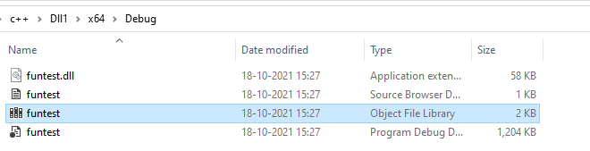
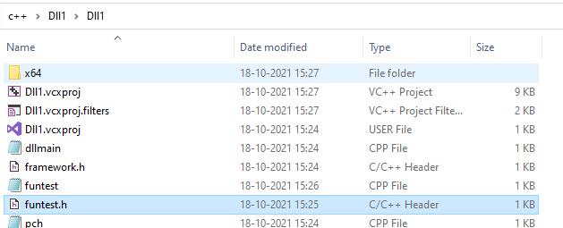
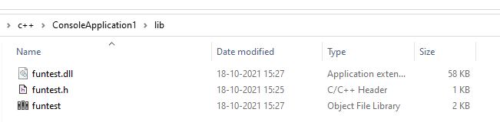
Copy below file from dll project to console project

Slide 7
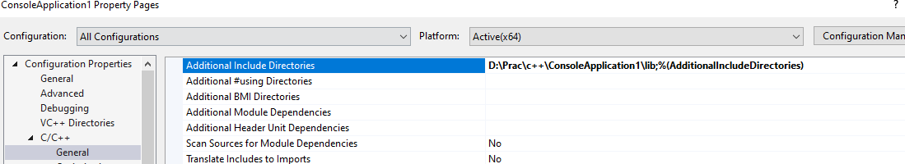
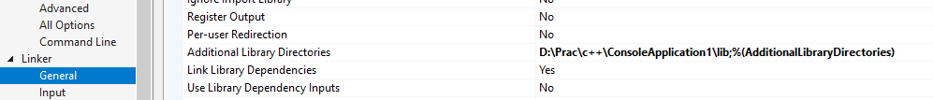
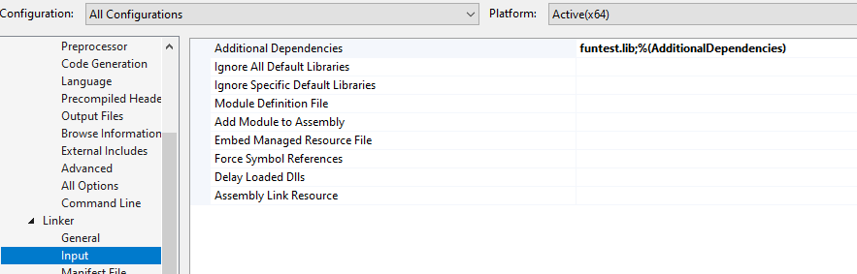

Slide 8
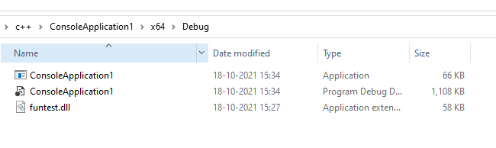
Dll file move to this location

